Slide 1

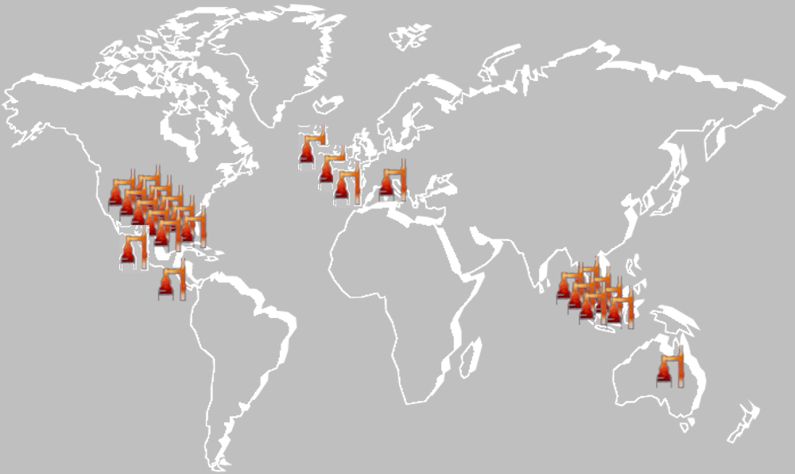
32 YEARS
5 CONTENENTS

Slide 2
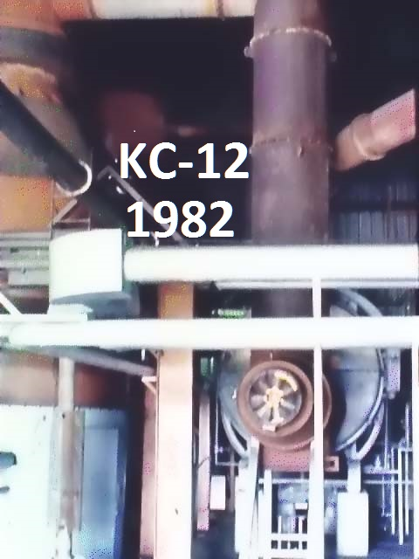
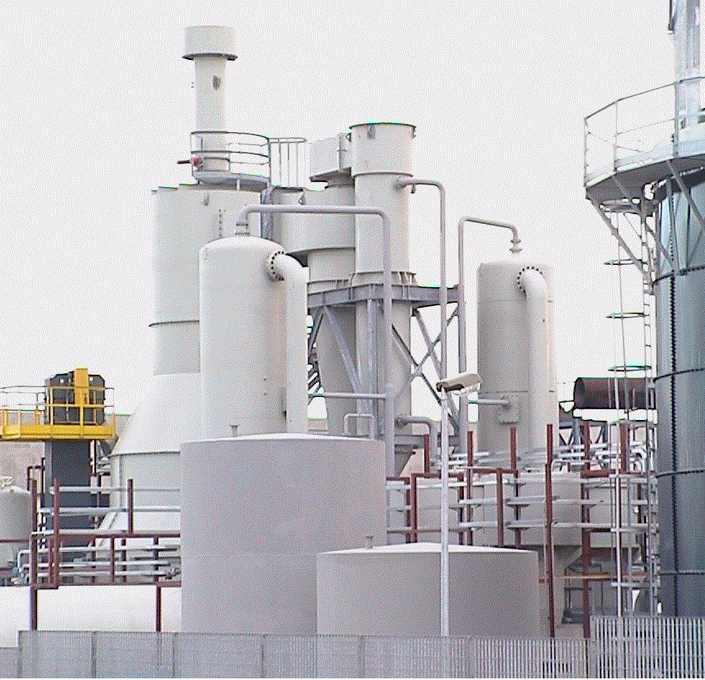
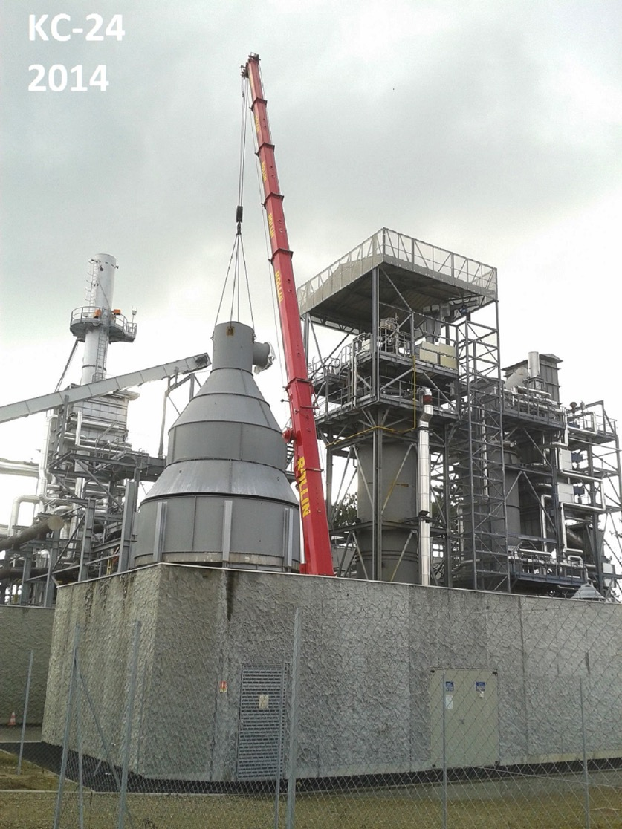
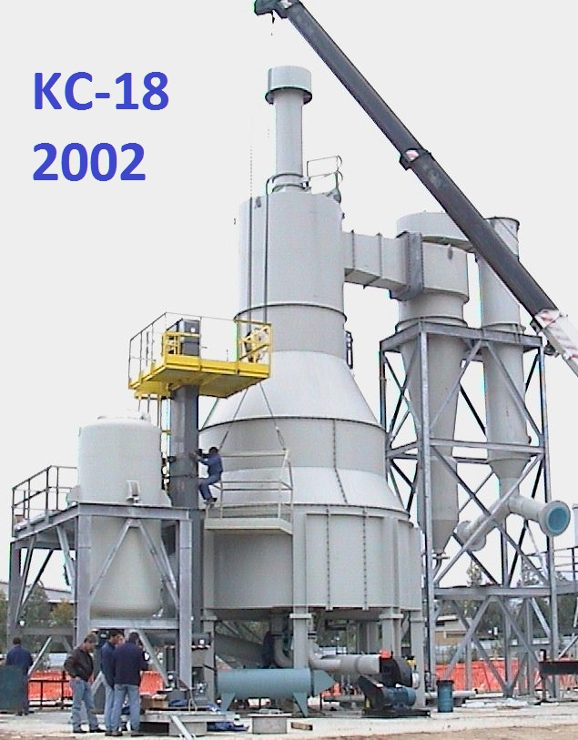
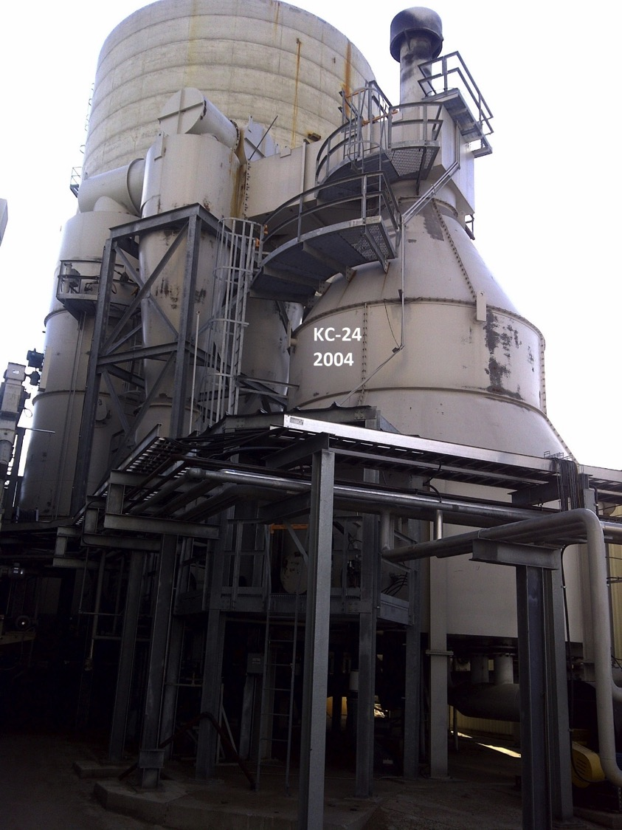
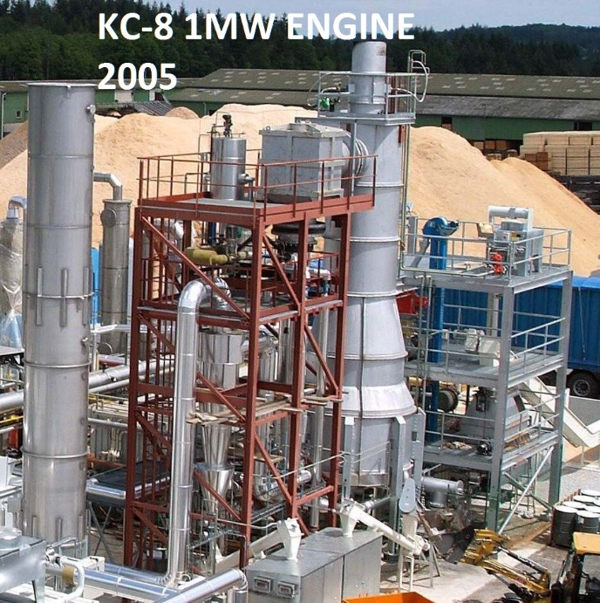
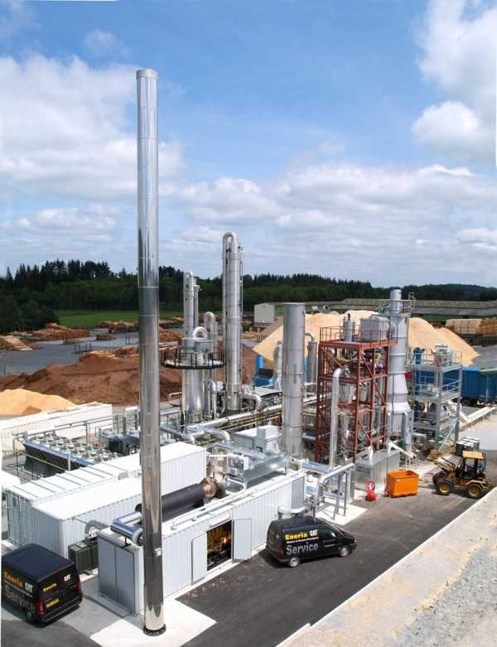
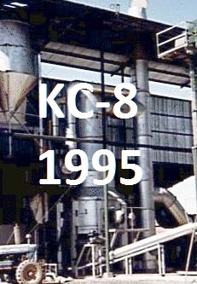
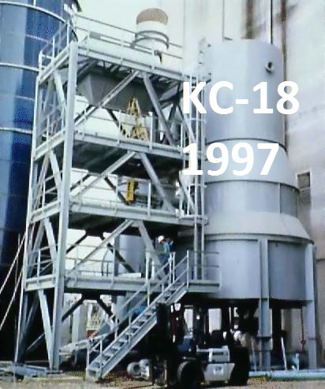
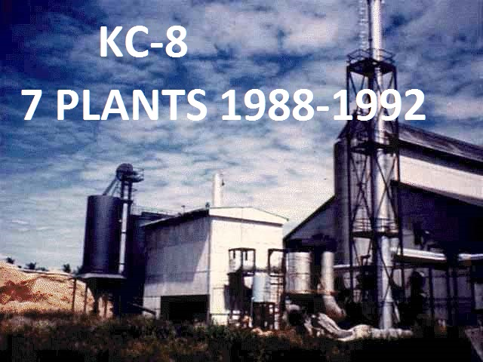
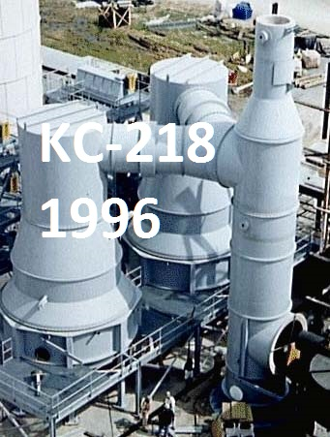
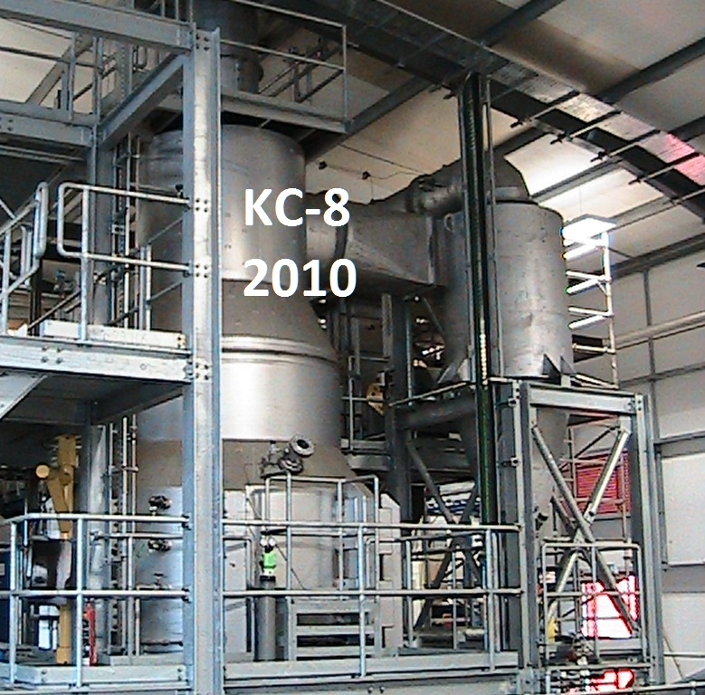
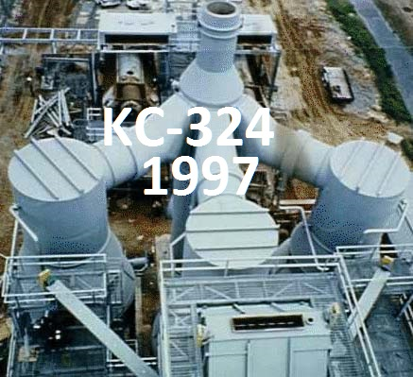
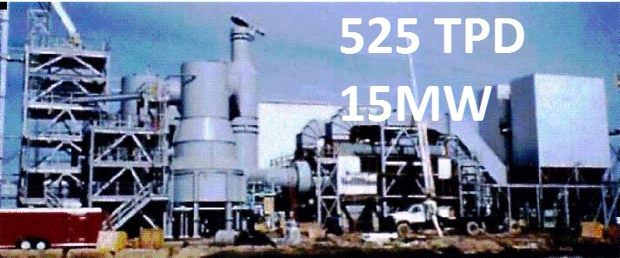

Slide 3
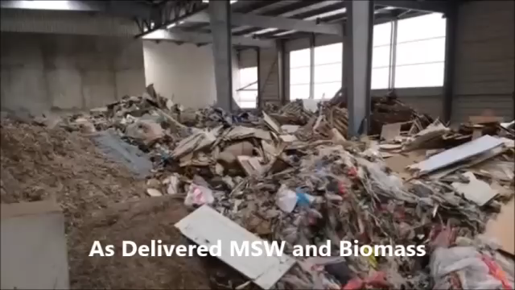
Waste-to-Energy
Facility
Morcenx France

Slide 4
The Gasification System
    Metered and measured feeding system.
    Water cooled components.
    Fixed grate, updraft.
    Precisely controlled gasification air to achieve desired syngas quality.
    Adjustable depth, agitated bed to control residence time and carbon conversion.
    Continuous ash discharge.
    Optional high temperature cyclone.
    Optional staged combustion systems.
    Optional syngas conditioning system.
The PRM Energy KC-Reactor® gasification system is a sub-stoichiometric, updraft system with:

Slide 5
Commercialized and
Proven Technology
High demand industrial applications
Installed and Working Around the World
Unit Scale from <1 to 10 tons per hour
Modularized from 10 to 55 tons per hour
Availability to 95%

Slide 6
Versatile
PRM has successfully utilized a wide variety of fuels over the past 30 years, including at least:
  18 Biomass fuel materials
  10 Waste stream materials
  3 Fossil fuel materials
The PRM Energy advanced gasification system can be configured for a variety of fuels and applications including:
Combined Heat and Power
Biomass-to-Energy
Energy from Waste
Co-Firing

Slide 7
PRM Energy Experience
After 30 years of designing, building and operating its gasifiers, PRM fully understands its systems and can easily predict the process with differing fuels in various applications.
The only requirement for projecting an outcome are proper analyses and proprietary system modeling.
PRM’s experience extends beyond the gasification system through the power island and encompasses auxiliary equipment and controls.

Slide 8
Delivery
Internally or with support from our strategic partners, PRM can arrange for the delivery of complete systems around the world.
Gasification system delivery times range from 10 months to 18 months, depending on the size, location, complexity and order backlog.
Complete power generation plants will require 18 to 30 months with the same dependencies plus major equipment lead times.

Slide 9
KC-Model Sizing Chart
Model | Biomass Input MT/hr at 6000 Btu/lb (3333 kcal/kg) | Range of Gross Potential Power Generation (kWe)
KC-8® | 1.00 | 861.6 | ─ | 1,077.0
KC-10® | 1.56 | 1,346.2 | ─ | 1,682.7
KC-12® | 2.25 | 1,938.5 | ─ | 2,423.2
KC-14® | 3.06 | 2,638.6 | ─ | 3,298.2
KC-16® | 4.00 | 3,446.3 | ─ | 4,307.8
KC-18® | 5.06 | 4,361.7 | ─ | 5,452.1
KC-20® | 6.25 | 5,384.8 | ─ | 6,731.0
KC-22® | 7.56 | 6,515.6 | ─ | 8,144.5
KC-24® | 9.00 | 7,754.1 | ─ | 9,692.6

Slide 10
Solid Fuel Characteristics
  Carbon 40% - 55%
  Hydrogen 5% - 8%
  Nitrogen <0.1% - 2.0%
  Oxygen 23% - 35%
  Sulfur < 1%
  Chlorine < 0.1%
  Ash 10% - 30%
  Water 10% - 30%
Typical Calorific Values for gasification fuels range between 12 and 22 megajoules per kilogram (MJ/kg), with the major components being

Slide 11
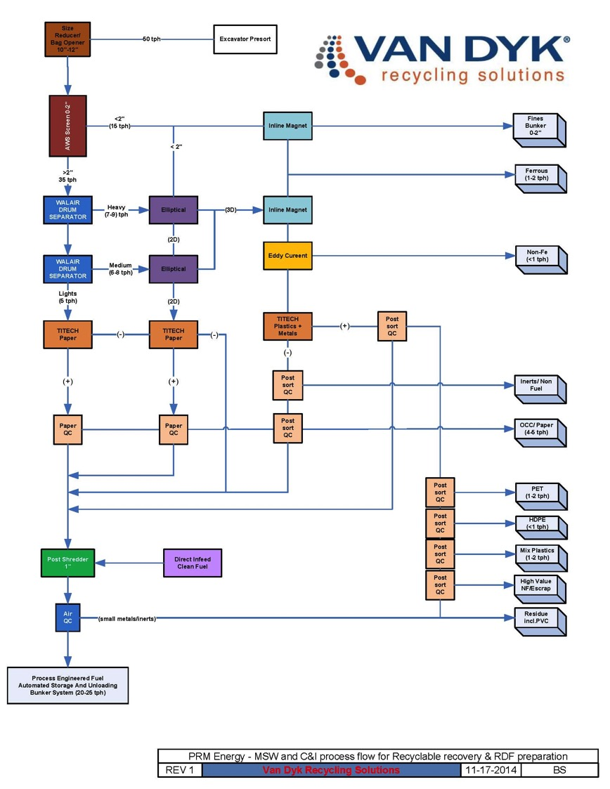
Materials Recovery
Facility

Slide 12
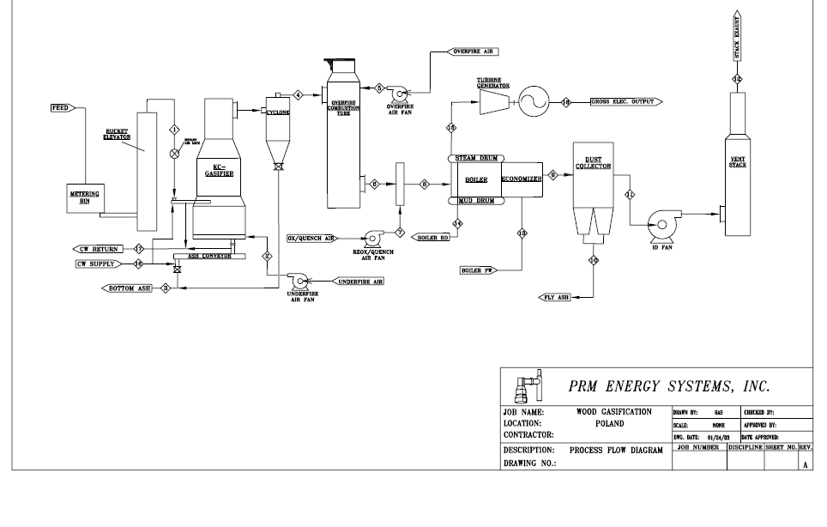
Process Flow – Steam/Power Generation

Slide 13
Process Flow – Engine Generation

